Slide 1
The Medicaid Home and Community-Based Settings Final Rule:
-
An Invitation to Excel in the Face of Adversity
Nebraska Association of Community Providers
Fall, 2019

Slide 2
The HCBS Settings Rule
A federal regulation that defines standards for settings where Medicaid HCBS services are provided using federal funding.
The Rule is the result of a nearly 5-year rule-making process during which over 2,000 public comments were submitted during multiple public comment periods.
The final Rule was issued in March 2014. States were given until March 2022 (8 years) to bring all existing HCBS settings into compliance with all of the standards in the Rule.

Slide 3
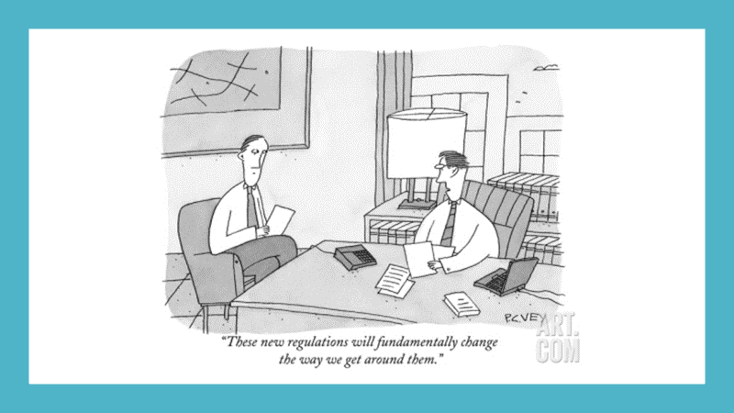
Intent Matters

Slide 4


Slide 5
Back to Mission
Most providers of HCBS have missions that are completely in line with the goals of the HCBS Settings Rule
They celebrate outcomes for individuals they serve that are completely in line with the goals of the HCBS Settings Rule
They want to create more of those outcomes…

Slide 6
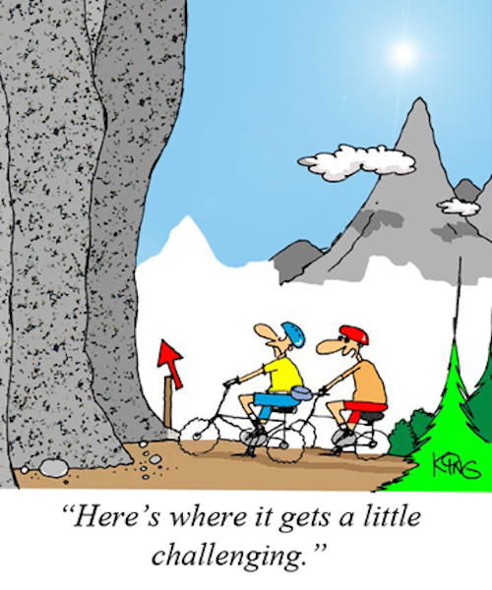
Let’s Not Pretend…

Slide 7


Beyond the Blame Game
The real challenges of doing this work are causing too many of us turn on each other.
Too much of our energy goes into feeling frustrated, defeated and unsupported by others.

Slide 8

Why Try to Excel in the
Face of Adversity?

Slide 9
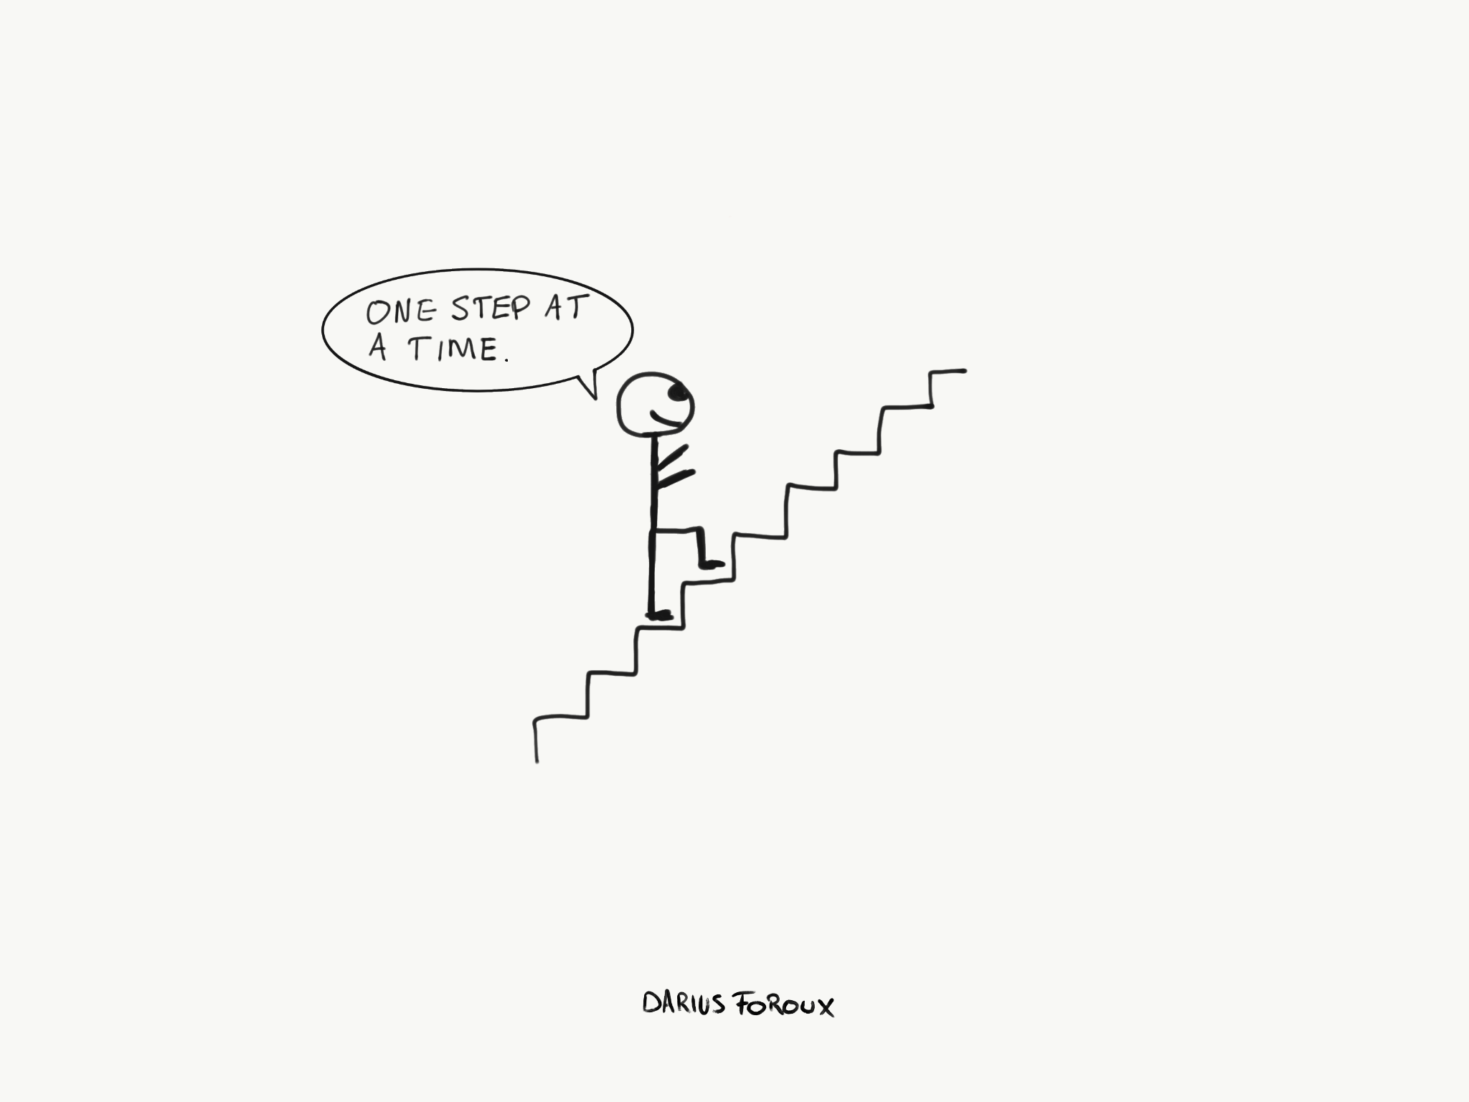
No Easy Path – But Opportunities Exist

Slide 10

Where I Like to Be…

Slide 11
Nebraska’s Comprehensive
DD Waiver
4500 people $317M
Average cost per person: $70,496
Residential Habilitation 57% of funding
Habilitative Workshop 16% of funding
Habilitative Community Inclusion 10% of funding
Independent Living 9% of funding
In-Home Residential 3% of funding
Supported Employment (Ind/Enclave/F-A) >3% of funding 98%
Notes:
Approved Waiver – Appendix J Waiver Year #3 (Current Year)

Slide 12
Nebraska’s
DD Adult Day Waiver
1055 people $16.84M
Average cost per person: $15,964
Habilitative Workshop 39% of funding
Habilitative Community Inclusion 30% of funding
Transportation 11.25% of funding
Supported Employment (Ind/Enclave/F-A) 10% of funding 91%
Notes:
Approved Waiver – Appendix J Waiver Year #3 (Current Year)

Slide 13
Nebraska’s 2 DD Waivers
5555 people $333.84M
Average cost per person: $60,097
Residential Habilitation 54% of funding
Habilitative Workshop 17% of funding
Habilitative Community Inclusion 11% of funding
Independent Living 8.5% of funding
Supported Employment (Ind/Enclave/F-A) 3.3% of funding 94%
Notes:
Approved Waivers – Appendix J Waiver Year #3 (Current Year)

Slide 14
DD Services Directory
Service | Support for Community Integration | Support for Competitive Integrated Employment
Residential Habilitation | No more than 3 individuals Focus on community integration | No mention
Habilitative Workshop | Takes place in provider owned or controlled setting | Service for people who don’t have employment goal and not seeking CIE
Habilitative Comm Inclusion | Minimum 51% of service must take place in community. Opps to make connections & interact w/ community members; volunteering; mobility training; community groups & activities | Community participation and skill development can springboard to increased interest and ability to obtain CIE

Slide 15
Problems with Individual Budgets
Based in part on historical utilization – not necessarily the services most aligned with HCBS Settings Rule
No budget adjustments for choosing integrated employment or community participation even though there is clear evidence these choices result in lower, long-term costs to serve
People inadvertently incentivized to choose cheaper services so they can maximize the units of service they receive
More services doesn’t necessarily mean a better life! Services with lower cost unit rates often result in DSPs paid more poorly, increased turnover and decreased quality.

Slide 16
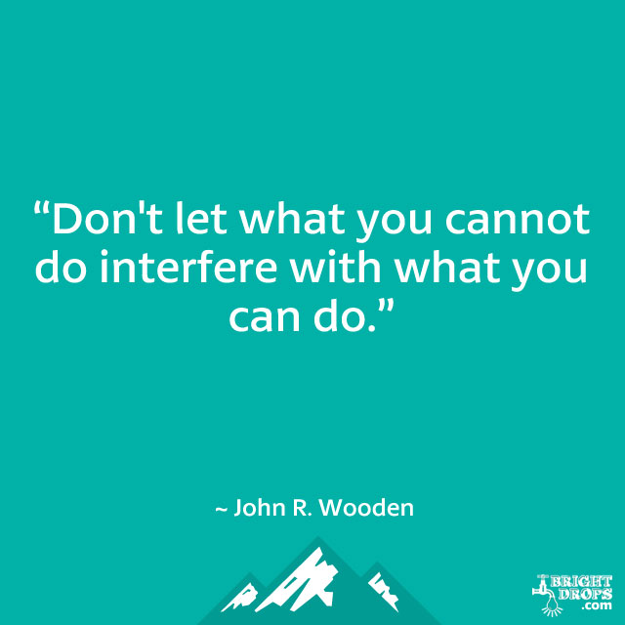

Slide 17
Opportunities in Nebraska
Services that don’t have prescribed staffing ratios that must be maintained to bill
  Providers elsewhere have used this flexibility to reduce staffing ratios in their own settings in order to free up resources to provide more individualized supports when people are in the community.
Some services that don’t limit billing only to face-to-face time
Residential models limited to maximum of three individuals – many states typically have larger group homes
Can have sleep-in night staff in residential

Slide 18
Opportunities in Nebraska (2)
No strictly designated service delivery timeframes/days of week
Not limited only to per diem rates that require a certain number of hours of service per day in order to bill
35 hours/week combined day/employment services limit
Transportation to/from not included in rates paid for day/employment services

Slide 19
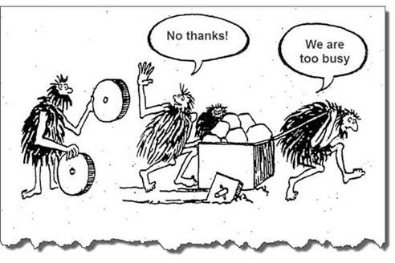
Interrupting Our Status Quo
Cartoon new rule new ways to get around it
Resistance to change
No thanks we’re too busy cartoon
Helping People Have Lives
Like Yours and Mine
Is inclusion dead? In but not of (gerbil run)
Merrill and my presentation from the TN provider conference

Slide 20
Asking Ourselves Frank Questions
Does what we support people to do currently represent all that you think people are capable of?
Does the amount of participation and involvement in and with the community that we support people to have currently represent the extent of inclusion you think your local community(s) are capable of and/or willing to embrace?
If you answered “no” to either of these questions, then the quest to find new ways to move forward is essential

Slide 21
Inspiration from Across the Pond
2000 Scottish Policy Strategy for People with IDD:
“The Same As You?”
Focus on helping People with IDD Have Lives Like People without IDD – minimizing or eliminating impact of disability on life opportunities and outcomes
See same principles in HCBS Settings Rule expectations
With this approach, ensuring choice means ensuring same choices that people without disabilities have
Notes:
2000 Scottish Learning Disability (IDD) Policy Strategy called “The Same As You?”

Slide 22
CMS Today
Opportunities without support are not opportunities
Focus on whether both opportunities and support to take those opportunities is available
People with IDD aren’t all the same…
  …but when we serve people in groups, they tend to lose their individual identities.
Notes:
March, 2019 Guidance

Slide 23
Opportunities (and Support) to Receive Services in the Broader Community with Same Access to
Broader Community as Other Members of the Community Have
Rule Requirement #1

Slide 24
Our Starting Point: Our Values
Every person has gifts and abilities that can bring value to others
People with IDD belong in our schools, workplaces, neighborhoods and communities
Being in the community doesn’t make you part of the community
The purpose of being part of your community is to learn and grow, contribute and build relationships
People, including people with significant ID or DD, should choose what they want to do and who they want to do it with
People who don’t have disabilities will want to know and form relationships with people who have disabilities if the right opportunities exist
Both will benefit from the relationships

Slide 25
Service Plans that Reflect the HCBS Settings Rule Opportunities & Support
What is important to the person? – Activities they enjoy; things they want to learn/do; relationships they want to have
Do we need to engage with the person in exploration of the local community - and its people - to begin to understand what the person wants?
Where are the activities/places/people that align with the person’s interests/goals?
What services/supports does this person need to participate in those activities, do or learn those new things, to help accomplish the things that really matter to him/her—not a program, but a unique life
We know community inclusion doesn’t just happen – what’s important beyond showing up?
HOW DO WE MAKE A SERVICE FOCUSED ON FUNCTIONAL
NEEDS/GOALS BE A SERVICE THAT SUPPORTS A GOOD LIFE?

Slide 26
Focus on Opportunities
Naturally occurring in the community and among community members
Avoid spending energy and resources substituting for what the community already offers, or could offer with support from us
No more program planning –
Operate more like a large family: Embrace the chaos!
Move from attendance-based focus to outcome-based focus

Slide 27
Building a Quality Schedule
Don’t start with when or where, if you don’t have to
Start with identifying what the person will be doing?
  What makes sense given the person’s interests and goals?
  AND
  What will give people the greatest opportunity to interact positively with other members of their community who share those interests and goals?
Then ask yourself, when and where do these things happen?

Slide 28
Valued Social Roles
“The purpose of life is a life with purpose.”
Gaining and maintaining valued social roles changes the wider community’s perception of people we serve.
Having valued social roles also reduces the need for a “Protection from Harm” approach because people are less likely to be viewed as vulnerable and exploitable.
How does the support we provide cause other members of the community to perceive individuals with IDD as competent, valued community members?

Slide 29
Social Role Valorization
DSPs today have never heard of it
Need to be acutely aware of how they should support people in the community in ways that promote the person’s value
How support people in ways that emphasize their strengths and their competence; knowing what not to d0

Slide 30
Criteria for Determining What is an “Appropriate Activity”
Matched to people’s interests (even better yet, their passions)
Matched to people’s goals (life goals, relationships goals, skill/independence goals, health/wellness goals, spiritual goals, etc.)
Offering opportunity to interact positively with other members of their community (first step to forming meaningful relationships that people can rely on)
Enabling people to hold valued social roles

Slide 31
Spontaneous Choice
Every day – starting by saying “what do you want to do today?”
Is that how we go about life?
Why do we sometimes (maybe more often than not) plan our schedule/activities in advance?

Slide 32
Planned/Thoughtful Choice
Get involved in things that really help a person pursue and achieve his/her interests/passions and goals
Get involved in things that provide opportunity to get to know new people and to be recognized and known and valued by other members of the community.
Get involved in things that provide a pathway to a valued social role

Slide 33

We Need Deeper
Community Mapping
Notes:
Colleen Garuder

Slide 34
Community Mapping
Establishing a broad knowledge of opportunities for:
  Community Involvement
  Membership (formal and informal)
  Volunteering
  Learning (through instruction or by doing)
  Exploring and pursuing specific interests
  Meeting like-minded people
Looking for opportunities that are not specifically for people with disabilities
                Beware of Too Much Focus on One-Time Events

Slide 35
Community Mapping
A DSP’s personal knowledge is not enough to develop good plans for supporting people in and with their community
Community Mapping done through “Trust Networks” yields deeper discovery of the community
“Company Roundtable” – getting community information from all employees/board members/volunteers of the agency

Slide 36
Community Mapping
Find a way to store what you have discovered! Save time in the future.
Searchable database
  Web-based (easy access for all staff, from anywhere)
  Searchable in multiple ways: by neighborhood/town/area; by interest area; etc.
  Note staff/board member who is most connected and can act as bridge-builder
Getting beyond the obvious opportunities to find the unique options for people…need to do Discovery and search in unorthodox ways

Slide 37
Involving Family & Natural Supports
Not just in traditional ways (planning, satisfaction surveys)
Letting you know about what’s going in in their community/neighborhood/church/etc. that they think the individual might enjoy - join in community mapping
Can existing natural supports (who don’t live with the individual) include the individual in what they do…if it begins with a DSP providing supports for a period of time?

Slide 38
DSP’s Fostering Positive Interactions and Relationships w/ Other Community Members
Will not do if they do not understand this is part of their role.
  Job description and orientation training should address
Will not do if they are not inclined toward - and comfortable with - doing this as part of their role.
  Recruiting should take account of this
Will not do if they don’t feel they “know how” and have seen it modeled in practice
  Training, mentoring, supervision, staff meetings should address this

Slide 39

Community Building
Options in Community Living
https://optionsmadison.com/publications/
Strategies, Tips, and Lessons
Learned from Experiences of
Community Building at Options

Slide 40
Volunteering
Volunteering at non-profits – supporting individual contribution
No need for formal arrangement between agency and non-profit where volunteering will be done
Focus on assisting person/people to become a volunteer like all other volunteers, in his/her own right.
No volunteering for service providers or for-profit businesses (except hospitals with formal volunteer programs).

Slide 41
We Need A Scheduler
Not A Middle Manager!
Making Change Means
New Roles for Everyone

Slide 42
Schedule
Schedule is not just when a person will receive the service
It’s also what will the person be doing each time s/he receives the service?
It’s also who will the person be doing these things with? [Not just identifying the DSP and who may also be receiving the service along with the person.]
It’s also where will the person be doing these things?

Slide 43
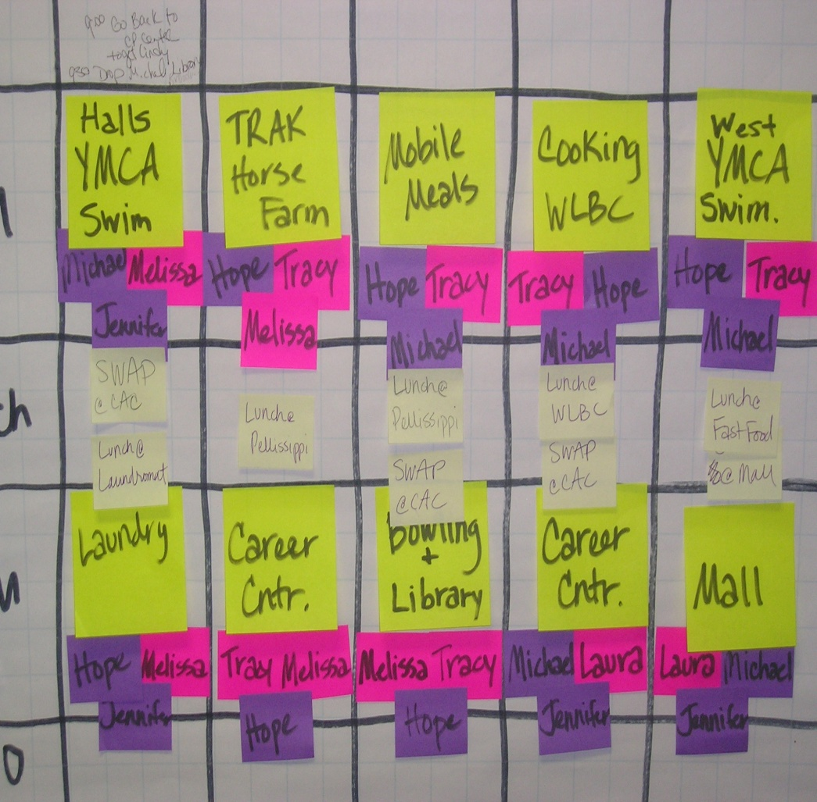
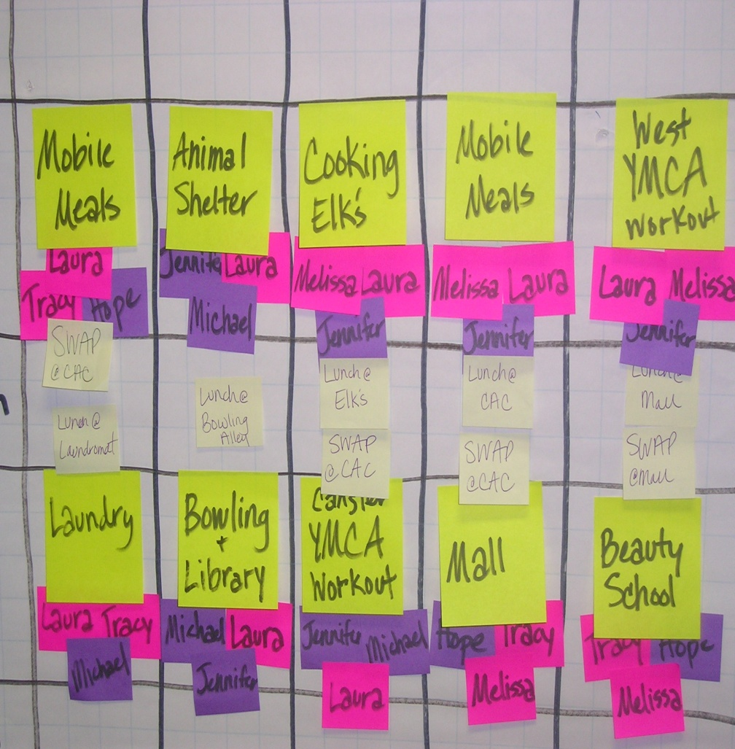
MASTER SCHEDULES
Notes:
Knoxville, TN

Slide 44
Eric’s Schedule
Monday Tuesday Wednesday Thursday Friday
Pick up time/ Staff/ Phone number | 8:30am Kevin 715-9716 | 8:45am Susan 705-9720 | 8:45am Rachel 705-8812 | 8:45am Rachel 705-8812 | 8:30 Nikki 905-9717
Activities/ Items needed | Drop to work 9:00 Pick Up from work 11:30 Library/ Personal Shopping/ Bowling $2 | Volunteer at Mobile Meals YMCA workout/ swim (bring bathing suit, shower stuff and change of clothes) | Drop to work 9:00 Pick Up from work 11:30 Volunteer at Angelic Ministries | Swap to Kevin’s group Grocery shopping-$5 Cooking class Laundromat (bring 1 load of clothes, soap, $3.00) | Drop to work 9:00 Pick Up from work 11:30 YMCA- workout (bring change of clothes) Banking- cash paycheck
Lunch/ Where/ $ or sack | Sack lunch CAC atrium | Lunch at Mall- Sack or $5 | Sack Lunch park | Cooking class at John 23rd on UT campus | Fast Food $5
Drop off time/ Staff/ Phone number | 2:45pm Kevin 715-9716 | 3:00pm Susan 705-9720 | 3:00pm Rachel 705-8823 | 3:00pm Kevin 715-9716 | 2:45pm Nikki 905-9716
Notes:
Knoxville TN

Slide 45
SUITABLE MATCH
SUITABLE MATCH means three things…
Compatible person(s)…
Who desire/need to receive service at same time(s) (compatible schedule), and…
Who desire to participate in the same activities while receiving the service (compatible interests).

Slide 46
SUITABLE MATCH (2)
No one has to have the same person(s) matched with them for all of the hours they receive a particular service.
Mike may be matched with Joe on Tuesday to go to the Tuesday night men’s bowling league
Mike may be matched with Donna on Thursday morning to go to volunteer at the food pantry
Mixing up matching can allow better compatibility of people and their interests

Slide 47
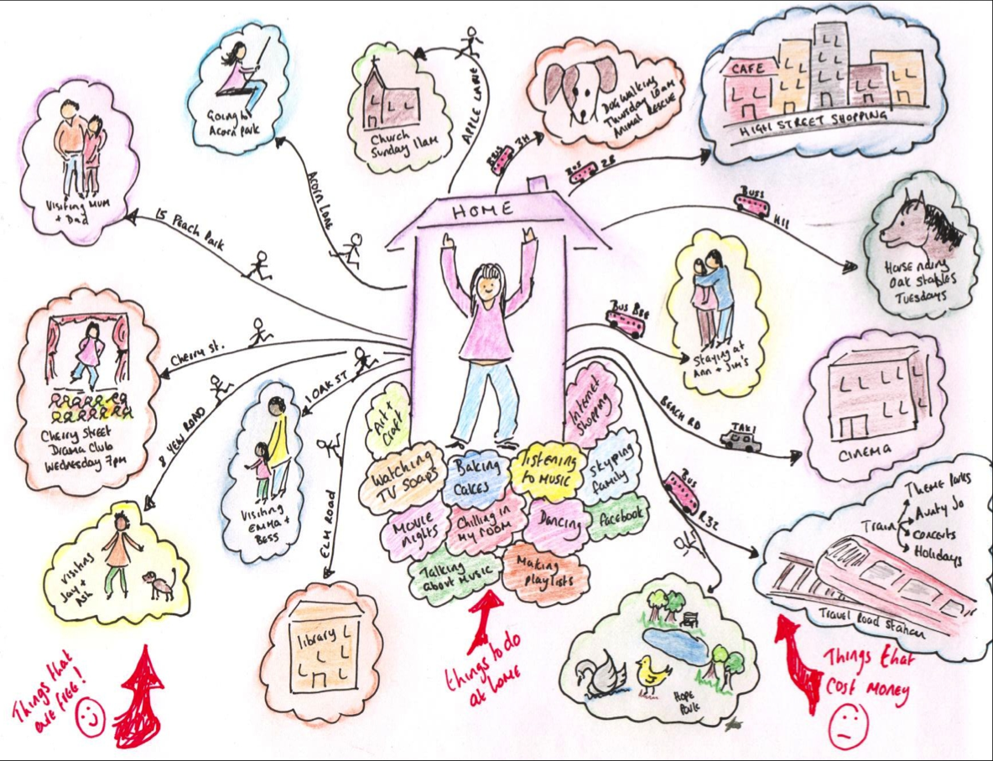
Home/Neighborhood/Hometown as Base for Life
Notes:
Pinterest
Discover Ideas about Developmental Disabilities: Community Mapping
https://www.pinterest.com/pin/397161260873607843/

Slide 48
Home/Neighborhood/Hometown as Base for Life
Isn’t home the typical base for most people?
If home is the base…
  Where do my support staff live?
  How much time do I spend in transit every day?
  Where do I start when looking for relationships, opportunities and employment?
  Where do people come from that I share support staff with?
Notes:
What if the group of people to choose from - for sharing staff to engage in community life – was everyone receiving supports in my neighborhood/hometown rather than just those people also supported by my provider agency?

Slide 50
We Need A Different Transportation Fleet!
Making Change Means
New Approach to What Agencies Own

Slide 51
We Need Different
Transportation Fleet
Staff using their own vehicles as standard practice
Converting large van fleet to smaller vehicles
Leasing instead of owning
Enabling staff to have a quality vehicle

Slide 52
We Need A Disaster!
Provider Transformation Spurred by Unexpected Disaster

Slide 53
Disaster-Led Transformation
A Flooded Facility
A Facility Fire

Slide 54
Build Service Funding Model Differently
From ground up, not from top down
Flatten organizational structure to reduce costs above direct service
Eliminate building costs
Kitchen table HQ: Briggs and Associates https://briggsassociates.org/wordpress/
Alternative Workspaces; mobile offices
Higher paid staff that can effectively embrace more autonomy, accountability and self-management

Slide 55
Agency Relationship with
Community Groups and Places
Do we make ourselves invisible whenever we can?
Do we avoid identifying people as service recipients whenever we can?
Ask yourself why people can’t just become involved as any other person would who is interested in becoming involved.
Resist establishing formal relationship between your agency and group/place – just facilitate participation naturally.

Slide 56
Other Resources
ENSURING EXCELLENCE IN COMMUNITY-BASED DAY SUPPORTS: A GUIDE FOR SERVICE PROVIDERS AND STAFF (2015) http://employmentfirstma.org/files/DDS_CBDS_web_F.pdf
Friends: Connecting People with Disabilities and Community Members (Amado, 2013) http://rtc.umn.edu/docs/Friends_Connecting_people_with_disabilities_and_community_members.pdf
Make the Day Matter!: Promoting Typical Lifestyles for Adults with Significant Disabilities (Rogan, 2007) https://www.amazon.com/Make-Day-Matter-Significant-Disabilities/dp/1557667136
The Meaningful Day Idea Book (New Mexico, 2009) http://www.cddlearningportal.org/ddsd/psm/module4/resources/meaningfuldayideabookall02102009.pdf

Slide 57
Additional Suggestions for Habilitation Service Providers
Set strategic/performance goals to exceed state policy which requires only 51% of Habilitation - Community Inclusion time to be in the community
Move to utilizing facilities as hubs rather than primary venues for service delivery [reduce size; consider relocation to support easy access to rest of community; structure so it is used for intended purpose]
Identify suitable locations in the broader community that can be used as safe meeting places for individuals meeting to participate together in community opportunities with shared staff

Slide 58

Additional Suggestions for Residential Providers
Do not use funding built into the rates to support community integration for non-emergency medical transportation (e.g. routine medical care; doctor appointments). Use N.E.M.T. available through Medicaid State Plan.
Work with typical landlords to enable individuals to lease directly from these landlords; explore third-party non-profit ownership opportunities… do not buy more properties.
https://www.movin-out.org/
Notes:
Below and here is the article on The Kelsey
https://www.disabilityscoop.com/2019/11/01/google-invests-in-inclusive-housing/27394/

Slide 59
END OF PART ONE
Discussion
Questions?
Comments

Slide 60
Opportunities (and Support) to Pursue Employment and Work in Competitive Integrated Settings
Rule Requirement #1
Rule Requirement #2

Slide 61
Employment as a Valued Outcome…
For Everyone
Far and away the best prize that life offers is the chance to work hard at work worth doing.
-Theodore Roosevelt

Slide 62
A Meaningful Day:
Not an Alternative to Employment
Employment as the anchor
in a meaningful day and
a meaningful life.
  -Pat Rogan, Indiana University

Slide 63
Opportunity and Support
Notes:
Source NCI 2017-2018

Slide 64
Helping People Understand the Choice to Work in Competitive Integrated Settings
Residential Providers Can Train Direct Support Staff To:
Point out and discuss job options during community participation
Support Job Shadows and Business Tours as part of community participation and connecting with members of the broader community
Support people to complete career/employment workbooks at home
Be Brave Enough to Start a Conversation that Matters.
-Margaret Wheatley

Slide 65
Assisting People to
Complete Workbooks
Career Planning Workbook
Employment Planning Workbook
Can be done in many services…

Slide 66
How Do Residential Providers Ensure They Are Supporting People with CIE?
Residential Providers Can Train Direct Support Staff To:
Engage people about interest at appropriate opportunities during normal service delivery
Ensure when interest is expressed, that information is conveyed to the case manager
Ensure evidence of strong interests, existing skills and tasks potentially transferable to employment is documented and shared with case manager

Slide 67
How Do Residential Providers Ensure They Are Supporting People with CIE?
Residential Provider Agencies Can:
Support people to complete VR application/referral; attend VR in-take meetings
Use agency and staff connections to local employers to assist with Job Search/Job Development

Slide 68
WorkLink program:
San Francisco, CA
“Our system is not made to support people with significant disabilities to go to work…WorkLink is how we adapted it.

Slide 69
Discovery As An Everyday Process
Habilitation that is 100% Community-Based
  Small ratios, 1:3- 1:4
  Hourly rates; $11.38/hour; maximum 30 hours/week
Person-centered discovery on continuous basis
  Start by encouraging the idea of work
  Use service time/experience to verify interests & skills
Focus service experience on strengthen skills beneficial for life and employment
  Motivation, soft skills
Use volunteer sites for career exploration and skill training
Focus includes addressing goals/needs beyond work.

Slide 70
Braided Services & Funding
WorkLink’s Toolbox
DDS Community Day Services
3:1 ratio/$11.38/hr
Capped at 30 hrs/week
ISP written annually
No designated program hours
Discovery & skill building
Non-work needs
  love/happiness, health, home, community- all domains
DDS-Habilitation Services
Long term job support
1:1 coaching for 20-30% of work hours
$30.82/hour
VR/Supported Employment
1:1 Job Coaching $30.82
Individual Placement/
  SE Milestones (Intake/Placement/Retention)
Pre-placement services
  PVSA $40/hr.
  Training
Subtract VR support hrs. from DDS 30 hr. limit

Slide 71


Facilitated Small Group Discovery
Notes:
http://www.leadcenter.org/resources/tool-manual/guided-group-discovery-resources-introduction-and-course-participant-workbook-and-facilitator-guide
Small group model of facilitated Discovery
Clarksville, TN American Job Center and ID Waiver Prevocational Provider Partnership

Slide 72
Supporting People to Work in Competitive Integrated Settings
Residential and Non-Work Service Providers Can:
Ensure direct support staff are giving individuals positive encouragement and affirmation for working and going to work
Be flexible about when people can receive services, to support individual work schedules
Residential providers can support people with clothing, packed meals, getting to work on time, accommodating receipt of earned income to supplement unearned income for room and board
Keep in good communication with job coaching agency about happenings outside of work that may impact the person’s performance at work

Slide 73
Supporting People to Work in Competitive Integrated Settings
What are you or your agency *most* proud of in terms of supporting people to explore and pursue competitive integrated work?
What is your or your agency *most* proud of in terms of supporting people with keeping work once they obtain a job?
Notes:
Frances

Slide 74
END OF PART TWO
Discussion
Questions?
Comments

Slide 75
Opportunities (and Support) to Control Personal Resources
Rule Requirement #1
Rule Requirement #3

Slide 76
Supporting Control of
Personal Resources
Ensure default policy is every individual has their own bank account and secure debit card or reloadable cash card
Staff assist people to pay their own bills, manage their own account, ideally through secure online system
Prioritize partnership(s) with local/agency bank(s) to make these options possible…and to provide opportunities for individuals to learn about money, budgeting, etc.
Notes:
Frances

Slide 77
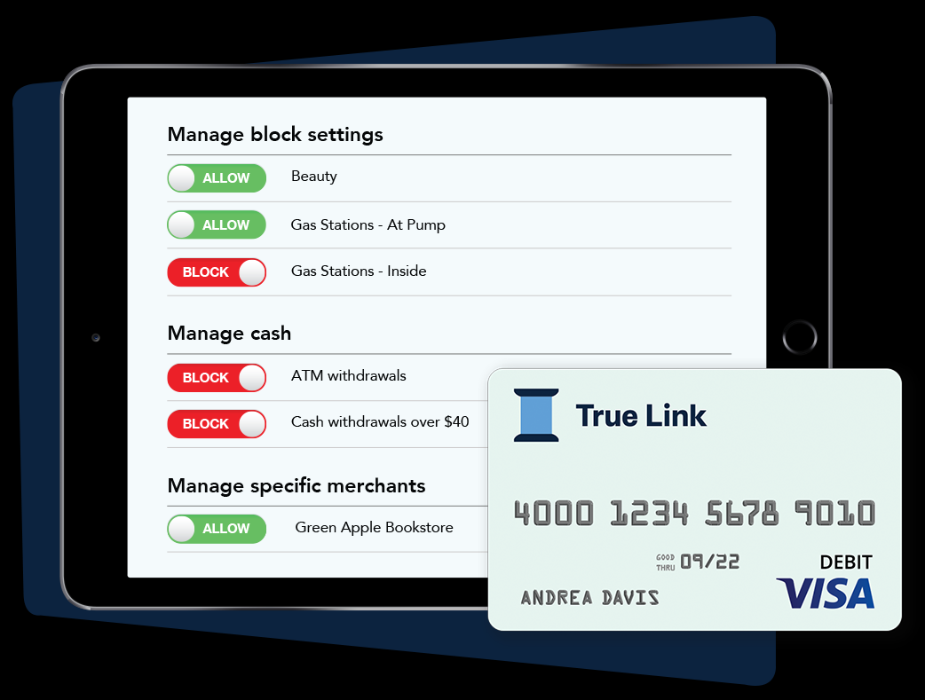
Resources Exist
https://www.truelinkfinancial.com/card/home-care-provider/

Slide 78
Supporting Control of
Personal Resources
Residential Settings:
Ensure individuals in paid work see their pay and it does not go directly to agency or representative payee account
Revisit agency serving as representative payee
Ensure every individual has their own safe and secure place to store cash, debit card and other personal resources
Notes:
Frances

Slide 79
Supporting Control of
Personal Resources
What are you or your agency *most* proud of in terms of giving people control of personal resources?
What is your or your agency’s *biggest* challenge in terms of giving people control of personal resources?
Notes:
Frances

Slide 80
END OF PART THREE
Discussion
Questions?
Comments

Slide 81
Opportunities (and Support) to Exercise Individual Initiative, Autonomy and Independence in Making Life Choices including
Daily Activities/Schedules and
Who to Spend Time With
Rule Requirement #1
Rule Requirement #4

Slide 82
Direct Support Staff Supporting Individual Initiative, Autonomy and Independence
Revive the Independent Living Movement’s principle of “Partial Participation”
…describes how individuals who are unable to complete all aspects of a task or activity still may be actively engaged or contributing by completing only parts of it...Within the context of community involvement, this principles suggests that even partial participation will promote self-determination that may contribute to quality of life.
(Tabor-Doughty & Shurr; 2017)
Notes:
From Chapter 12 of Life Skills for Secondary Students with Intellectual Disability © 2017 Sage Publications
Baumgart, et. al. (1982)
Wehmeyer (2007 and Wehmeyer and Schwartz (1998)

Slide 83
Direct Support Staff Supporting Individual Initiative, Autonomy and Independence
Ensure direct support staff understand and use “Person-Centered Active Support”
http://www.activesupportresource.net.au/
https://youtu.be/dNKi7ndwvqM
Notes:
3 Videos to View: Length 2:18 + 2:40 + 2.55

Slide 84
LIFE CHOICES
Who decides…or decides on the options people will have to choose from?
What are you or your agency *most* proud of in terms of giving people choices?
What is your or your agency’s *biggest* challenge in terms of giving people choices?

Slide 85
LIFE CHOICES (2)
How do we react when people say “no” or when people show us they are unhappy with what is going on?
What are you or your agency *most* proud of in terms of responding to “no” or obvious unhappiness?
What is your or your agency’s *biggest* challenge in terms of responding well to “no” or obvious unhappiness?

Slide 86
LIFE CHOICES (3)
To what extent do people’s lives look different/unique?
Residential: People who live together but aren’t friends or
family
Non-Residential: People who you serve in Habilitative
Workshop or Habilitative Community Inclusion
How often are people supported to participate in and with their community in a way that has been uniquely developed for them?

Slide 87
LIFE CHOICES (4)
What are you or your agency *most* proud of in terms of helping people have unique lives?
What is your or your agency’s *biggest* challenge in terms of helping people have unique lives?

Slide 88
Choices in the Person-Centered Plan
Should not trap people in a certain life until the next plan review
The person-centered plan is only person-centered if the person at the center can tell us they want to change it
The PCP is not a treatment plan - it’s a life plan…and life is ever-evolving for all of us

Slide 89
Enabling Independence
In fee-for-service system, assisting people to be more independent often means less revenue for the agency.
What is the silver lining?

Slide 90
Increasing Independence:
Reducing Negative Impact/Costs of DSP Workforce Crisis
Individuals Gain Increased Independence
Independence is a Win for the Person and Provider
Less DSPs Needed
Less Vacancies; Lower Recruitment & OT Costs
DSPs Can Be Paid More
DSPs Are Less Overworked
DSPs Less Likely to Leave
Agency Can Do More Selective Recruitment
Increased DSP Longevity
Notes:
If we right-size the supports people need and work to increase/maximize their independence (through natural supports, use of technology, peer-to-peer supports) we will need to provide less hours of service. The result is that providers will not need to recruit/retain so many DSPs (which reduces the negative impact of the workforce crisis on the provider).
Right now, providers may minimize need for DSPs primarily by providing services that congregate people. The HCBS Settings Rule drives toward more community-based and individualized services so new strategies for minimizing the need for DSPs need to be developed.

Slide 91
Increasing Independence:
Shared Savings and Impact on DSP Workforce Crisis
Individuals Gain Increased Independence
Independence is a Win for the Person, Provider & Funder
Less Hours of Service Are Needed;
Less DSPs are Needed
State Can Reinvest Savings into Higher Reimbursement Rates
DSPs Can Be Paid More
Less Vacancies/Overtime so DSPs Are Less Overworked
DSPs Less Likely to Leave
Agency Can Do More Selective Recruitment
Increased DSP Longevity
Notes:
If we right-size the supports people need and work to increase/maximize their independence (through natural supports, use of technology, peer-to-peer supports) we will need to provide less hours of service. The system can then afford to pay providers more for the hours of service they do provide, and the result is that providers will not need to recruit/retain so many DSPs (which reduces the negative impact of the workforce crisis on the provider).
Right now, providers may minimize need for DSPS primarily by preferring to provide services that congregate people. Not consistent with policy goals of integration/inclusion, individualization of supports, etc.

Slide 92
Potential for Increased Independence: Many Strategies Can Be Used
Systematic Instruction
Technology including Remote Supports, PERS, Assistive Tech and Adaptive Aids
Natural Supports; Generic Community Resources
Peer Supports – Shared Responsibilities
Notes:
Can work in community or at home.

Slide 93
END OF PART FOUR
Discussion
Questions?
Comments

Slide 94
Opportunities (and Support) to Choose Services and Supports and Who Provides These;
Opportunities to Choose a Non-Disability Specific Setting
Rule Requirement #1
Rule Requirements #5 and #6

Slide 95
Choosing Staff
Ensure individuals have regular opportunities to participate in interviewing/selecting staff the agency will hire
Give individuals the ability to state their clear preferences for staff: age; gender; hometown; personality traits; interests
  Use this information to match staff to individuals and track how often/to what extent matches are made.
Provide process for individuals to request a change in staff if there is an issue

Slide 96
Choosing Staff
What are you or your agency *most* proud of in terms of enabling people to choose their support staff?
What is your or your agency’s *biggest* challenge in terms of enabling people to choose their support staff?

Slide 97
Choice of Non-Disability-Specific Setting
Applies for every service category, not just residential.
Can providers offer each service they provide (or a largely equivalent service) in non-disability specific settings if an individual prefers this?
A state must also offer choice of setting in person-centered planning process and for each service, the option of a non-disability-specific setting must be available, offered, documented as offered in the PCP and documented in the PCP if the person chooses the non-disability specific setting option(s).

Slide 98
Choice of Non-Disability-Specific Setting
What are you or your agency *most* proud of in terms of offering the people you serve choice to receive services in non-disability specific settings?
What is your or your agency’s *biggest* challenge in terms of offering the people you serve choice to receive services in non-disability specific settings?

Slide 99
END OF PART FIVE/SIX
Discussion
Questions?
Comments

Slide 100
Closing Thoughts

Slide 101

High Hopes for Adulthood

Slide 102
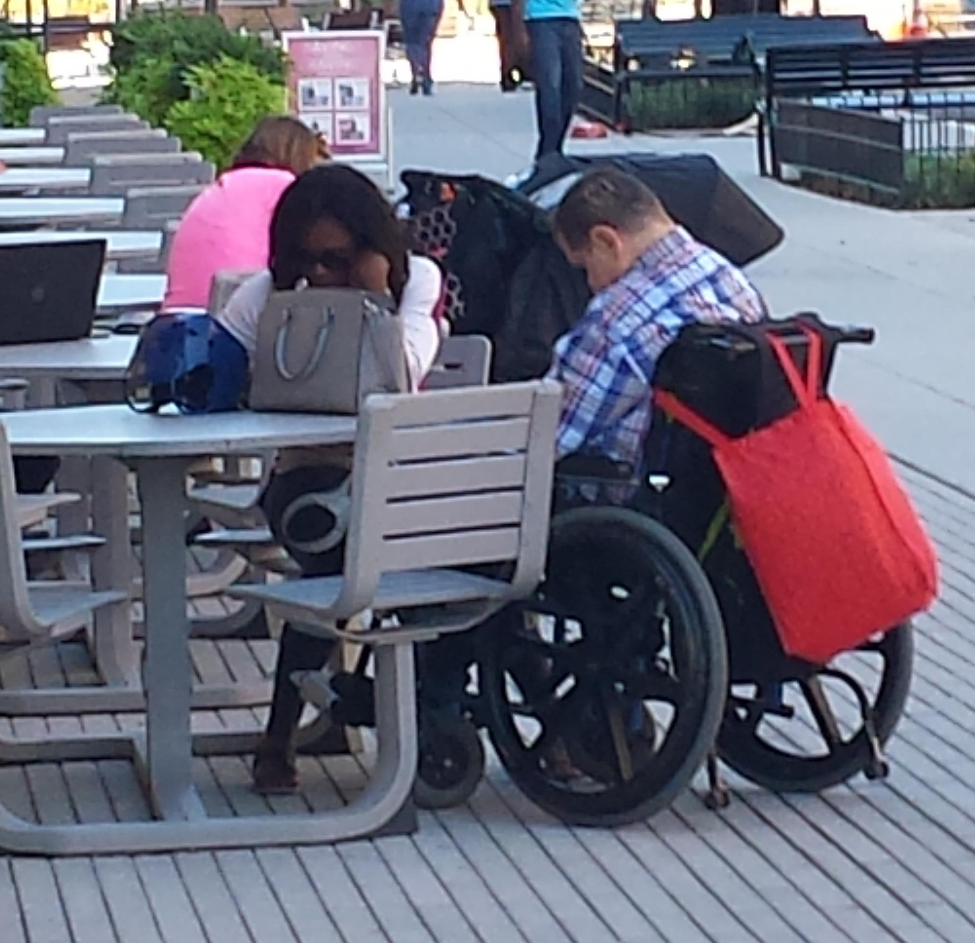
Worst Nightmare for Adulthood

Slide 103
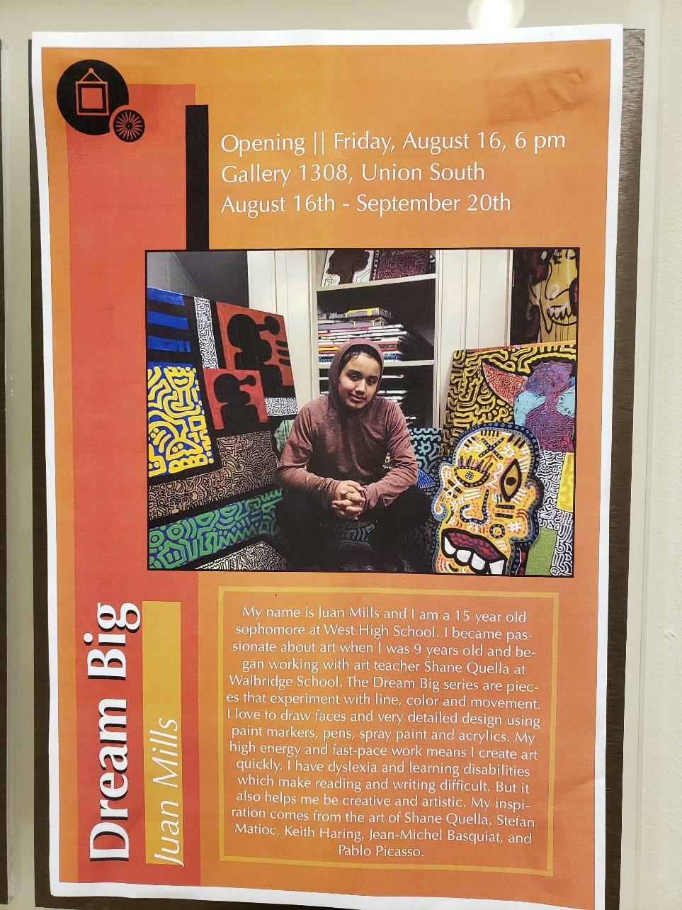
The Power of Opportunities and Support

Slide 104
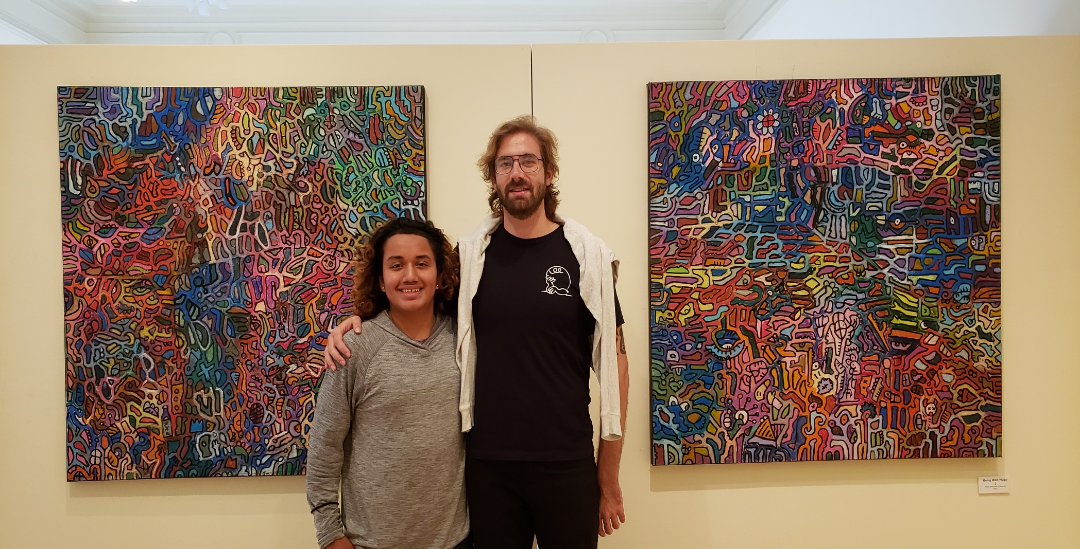
Community Connections = Opportunities = Contribution = Valued Person = Self-Esteem…

Slide 105
Presenter Contact Information
Lisa A. Mills, PhD
Moving To A Different Drum, LLC
lisamills@mtdd.onmicrosoft.com
608 225 4326

